Slide 1
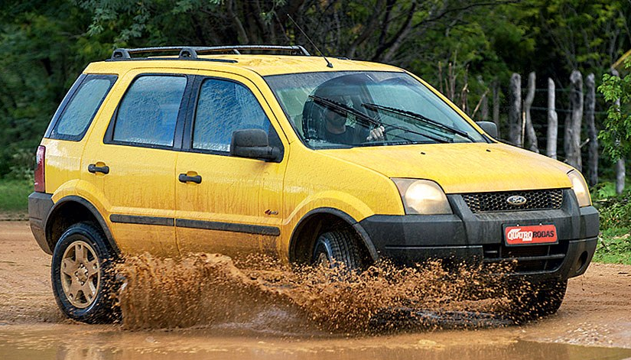


2003
2013
2018

